Slide 1
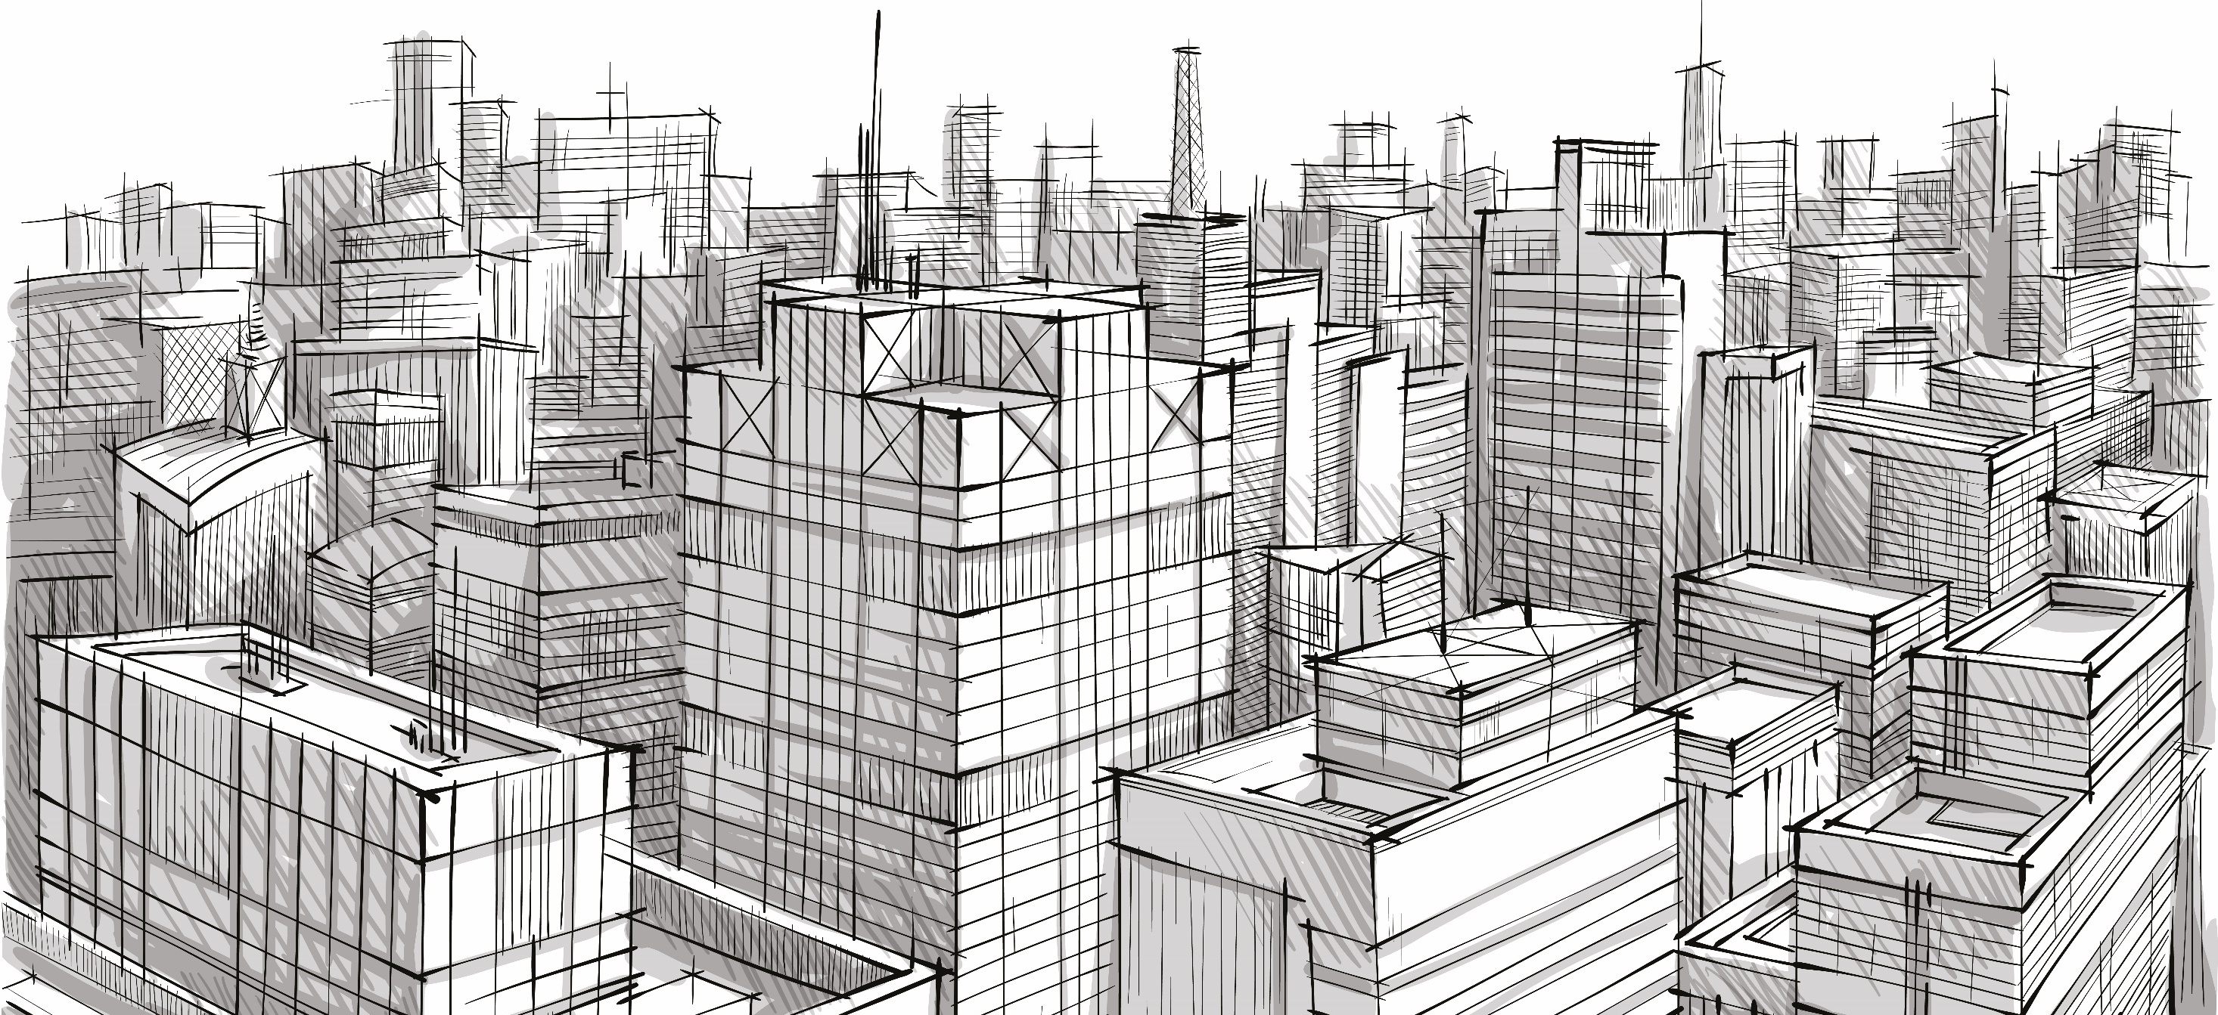
Supported by

Slide 2
Buildings don’t just provide shelter Building services make them come alive
www.cibse.org/careers
Supported by CIBSE Patrons

Slide 3
The challenge Buildings contribute 50% of all carbon emissions that cause climate change
www.cibse.org/careers
Supported by CIBSE Patrons

Slide 4
The aims Reduce carbon emissions and make safe comfortable places to live, work and play
www.cibse.org/careers
Supported by CIBSE Patrons

Slide 5
The solutions Conserve resources Find alternatives Use renewables
www.cibse.org/careers
Supported by CIBSE Patrons

Slide 6
Building the BIG picture 1. Plan 2. Design 3. Construct 4. Commission 5. Operate and maintain
www.cibse.org/careers
Supported by CIBSE Patrons

Slide 7
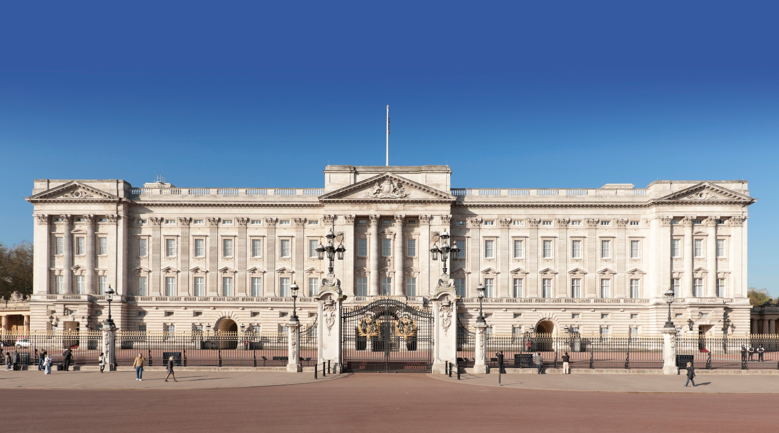
House School Office Cinema Theatre TV Studio Hospital Shopping Centre Gym Stadium Swimming Pool Laboratory Factory Museum
www.cibse.org/careers
Supported by CIBSE Patrons

Slide 8
Projects New
Refurbish
Extend
Refit
www.cibse.org/careers
Supported by CIBSE Patrons

Slide 9
Engineering for…
heating, ventilation, air conditioning, water supply
& drainage, lighting,
electrical supply, acoustics,
mechanical,
controls & IT
www.cibse.org/careers
Supported by CIBSE Patrons

Slide 10
You might be a
Systems designer
Consulting engineer
Energy consultant
Estimator
Researcher
Maintenance engineer
Contractor
Project manager
www.cibse.org/careers
Supported by CIBSE Patrons

Slide 11
Rewards
Job satisfaction
Global opportunities
Excellent rewards
Rapid promotion
www.cibse.org/careers
Supported by CIBSE Patrons

Slide 12
At the forefront
of technological development
www.cibse.org/careers
Supported by CIBSE Patrons

Slide 13
Have a good day in a career you can be proud of.
Every day is different.
www.cibse.org/careers
Supported by CIBSE Patrons

Slide 14
How important are the letters after your name?
Eng Tech LCIBSE
IEng ACIBSE
CEng MCIBSE
www.cibse.org/careers
Supported by CIBSE Patrons

Slide 15
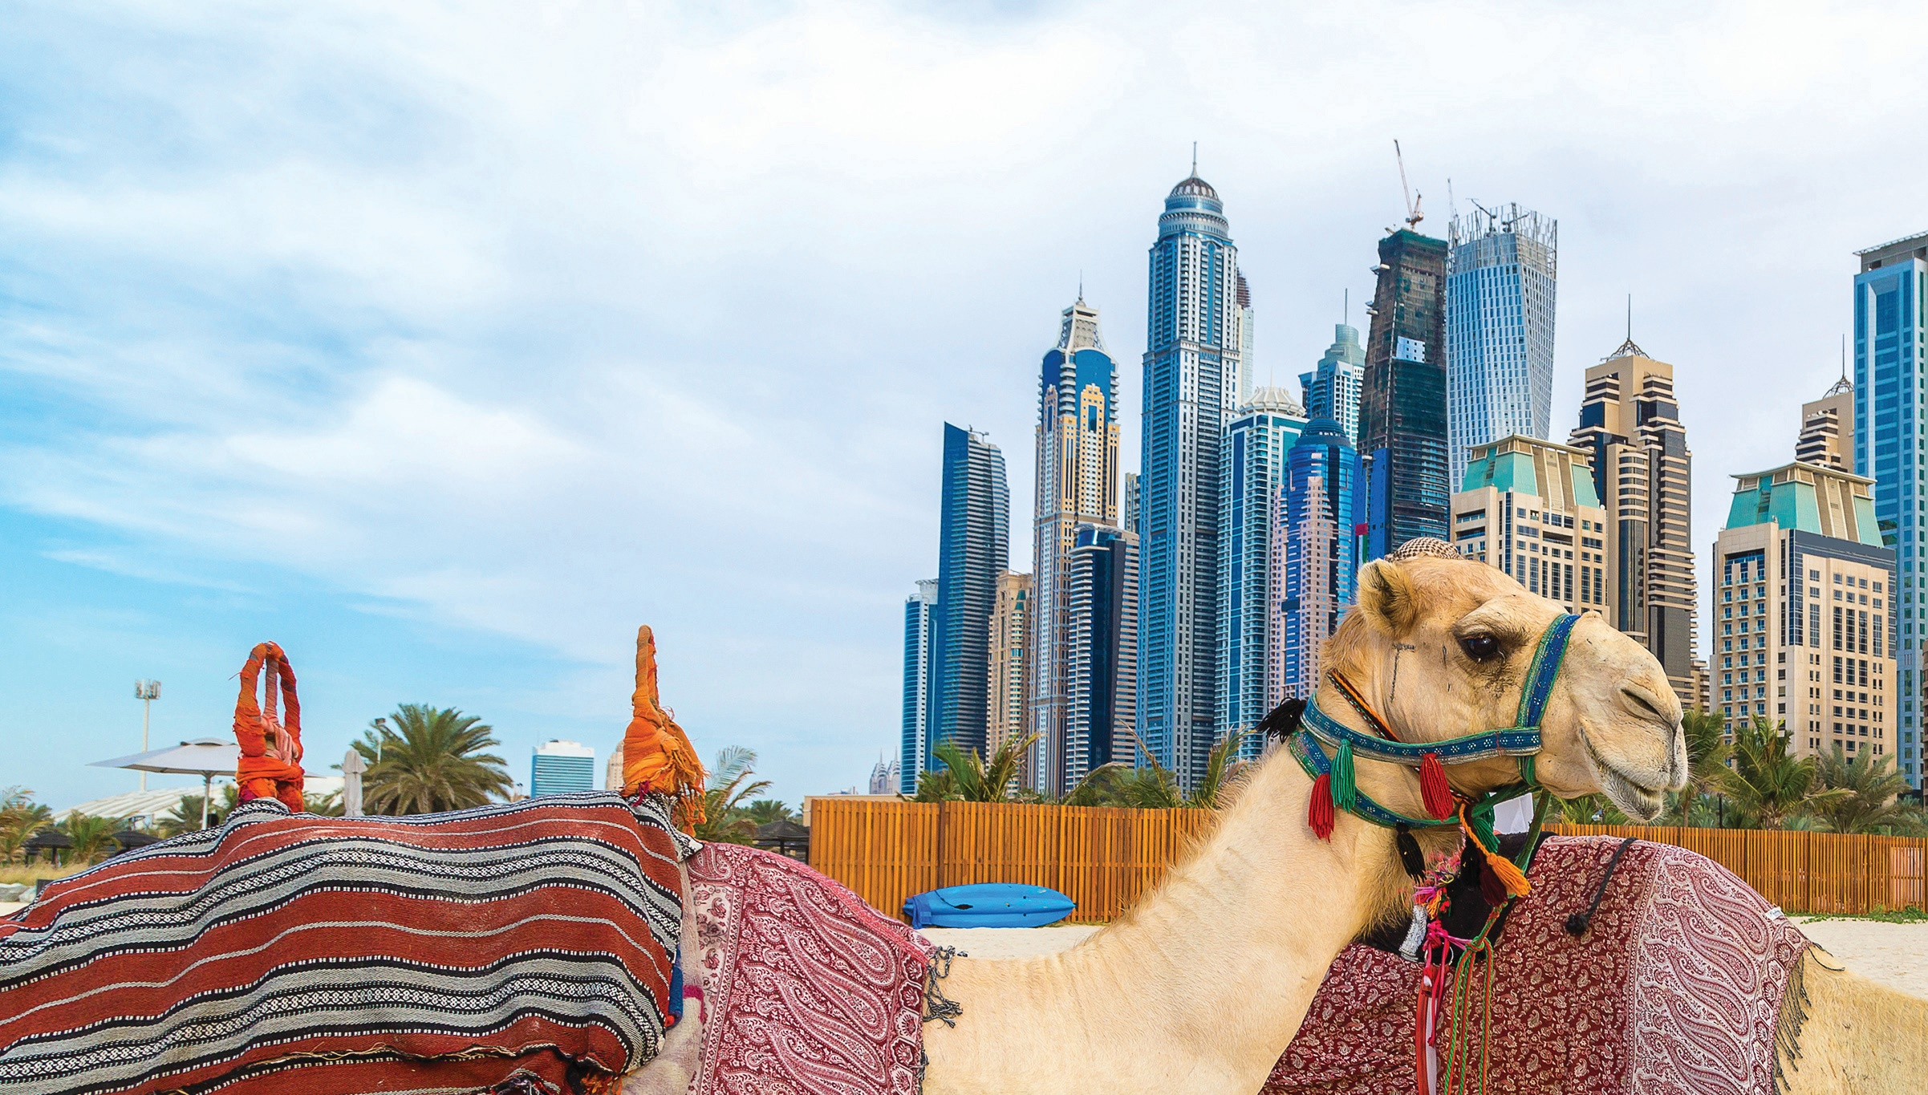
Going global
UK firms create ground breaking sustainable building services for landmark projects throughout the world.
www.cibse.org/careers
Supported by CIBSE Patrons

Slide 16
What do I need to become a building services engineer?
www.cibse.org/careers
Supported by CIBSE Patrons

Slide 17
Are you creative?
Do you
Solve problems?
Make connections?
Make things work?
www.cibse.org/careers
Supported by CIBSE Patrons

Slide 18
Apprenticeship
College
University
www.cibse.org/careers
Supported by CIBSE Patrons

Slide 19
To sum up
Excellent rewards
Rapid promotion
Global demand
Ground breaking projects
Harness new technologies
Make a difference
www.cibse.org/careers
Supported by CIBSE Patrons

Slide 20
Find out more
cibse.org/careers
@CIBSE
LinkedIn - CIBSE
cibse.org/youtube
cibseblog.co.uk
Soundcloud.com/build2perform
Supported by

